Slide 1
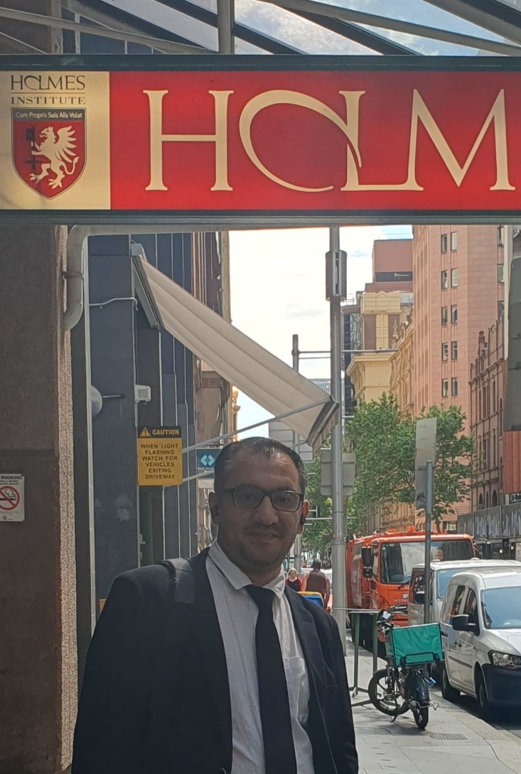

HI6034: Enterprise Information Systems Preparation for Online Test 2 (Week 3 and 4)

Slide 2
Question 1
A sales order can be created without first making a quotation.
True
False
Explanation: A quotation is optional. You can create a sales order directly.

Slide 3
Question 2
Sales processes in SAP S/4HANA usually do not involve the finance (accounting) team.
True
False
Explanation: Finance is involved because sales affect billing and payments.

Slide 4
Question 3
The “Post Incoming Payments” app is used to record money received from customers.
True
False
Explanation: This app is used when customers pay their invoices.

Slide 5
Question 4
The “Create Outbound Deliveries” app is used to start the delivery of goods to customers.
True
False
Explanation: It begins the shipping process for customer orders.

Slide 6
Question 5
A customer inquiry is a confirmed order that must be fulfilled.
True
False
Explanation: An inquiry is just a question from the customer, not a confirmed order.

Slide 7
Question 6
Which term means goods have been sent to the customer and stock is reduced?
Delivery Note
Goods Issue
Purchase Order
Inventory Check
Explanation: Goods Issue updates the system when items leave the warehouse.

Slide 8
Question 7
SAP S/4HANA supports the full order-to-cash process from order creation to payment.
True
False
Explanation: The system handles the whole process from sales to receiving money.

Slide 9
Question 8
Which of the following is NOT part of the order-to-cash process?
Creating a sales order
Delivering goods
Receiving payment
Producing the product
Explanation: Manufacturing belongs to a different process (production), not order-to-cash

Slide 10
Question 9
Which field is important when entering sales data for a customer?
Customer’s age
Sales Organization
Supplier location
Warehouse number
Explanation: It shows which part of the company is responsible for sales.

Slide 11
Question 10
Which app is used to create or manage a customer in SAP S/4HANA?
Create Delivery
Post Incoming Payments
Maintain Business Partner
Display Stock
Explanation: Customers are created and managed as business partners in SAP.

